Slide 1
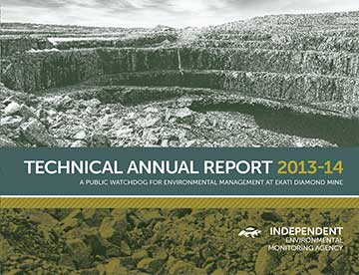
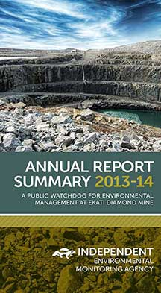
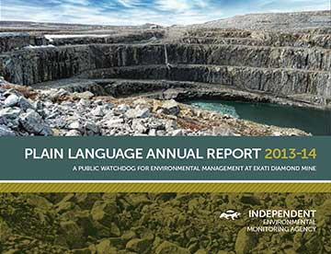
Independent Environmental Monitoring Agency
2013-14 Annual Report Summary
December 4, 2014

Slide 2

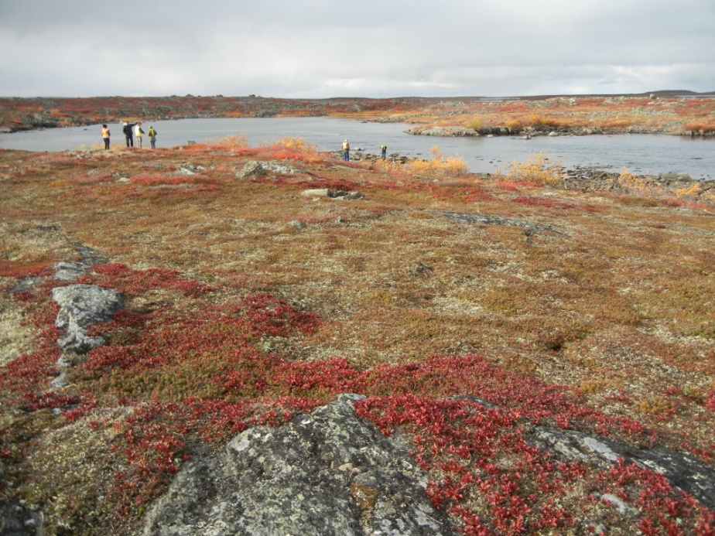
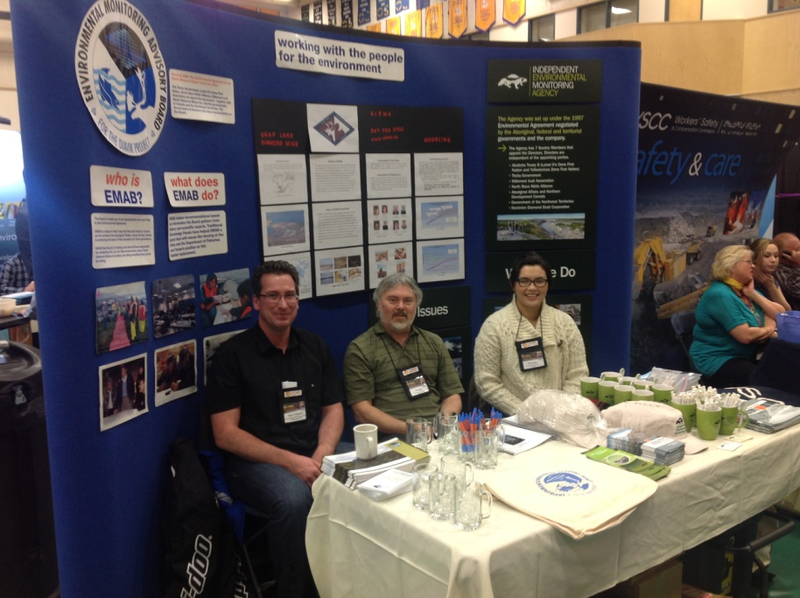
Outline
Agency Activities 2013-14
Wildlife
Water and Fish
Air Quality
Traditional Knowledge
Processed Kimberlite and Waste Rock Management
Closure and Reclamation
Regional Monitoring and Cumulative Effects
Assessment of the Regulators
Assessment of BHP Billiton
Recent Agency Activities

Slide 3

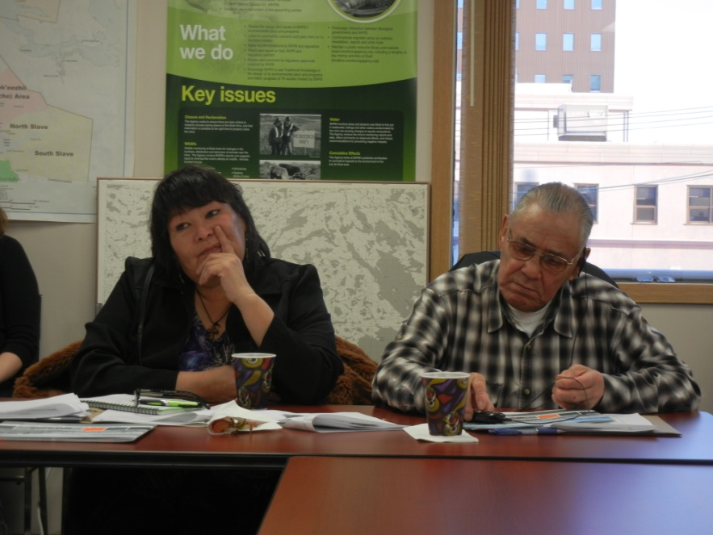
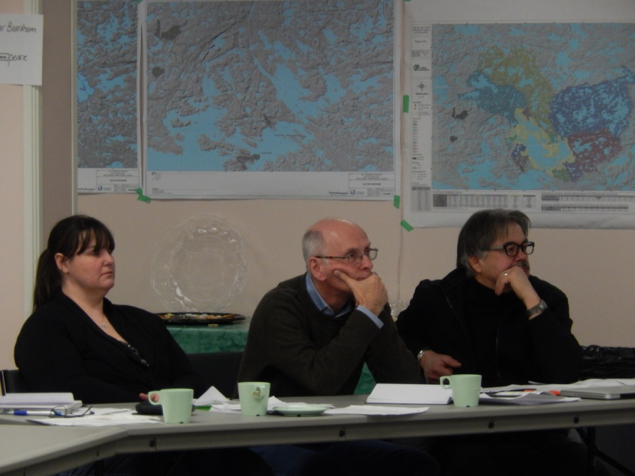
Agency Activities 2013-14
4 board meetings, site visits to Ekati, and AGM
Implementation of Agency Communications Plan
Agency visit to Dettah and N’dilo in March 2014
Participated in Jay-Cardinal Project and Lynx Project reviews
Meetings with signers of Environmental Agreement and Inter-Agency Coordinating Team

Slide 4
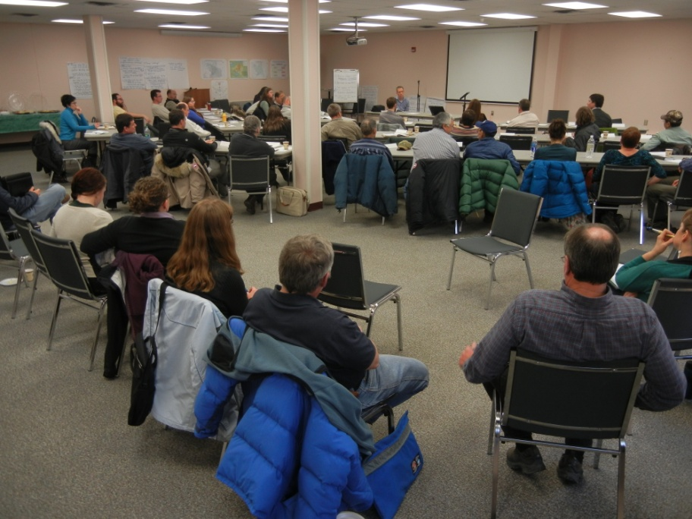
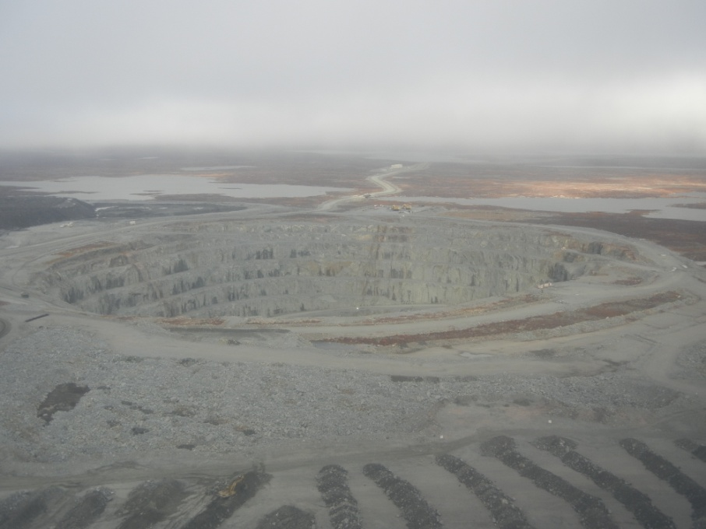
Agency Activities 2013-14
Participated in Bathurst Caribou Range Plan
Participated in meetings on proposed changes to the Ekati Environmental Agreement
Meetings on financial security for Ekati

Slide 5
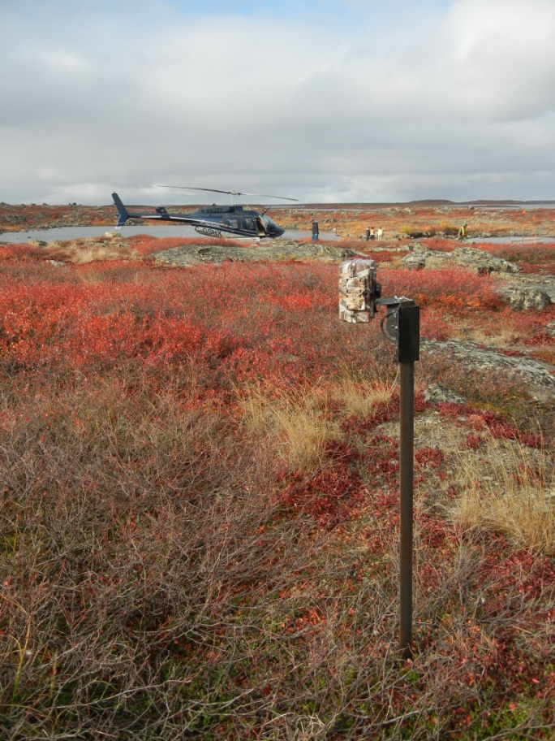
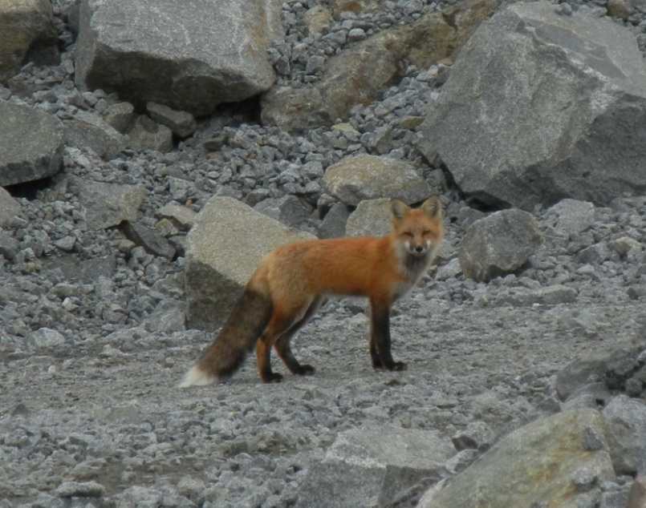
Wildlife
GNWT continues work on guidelines for wildlife monitoring
Agency reviewed 2013 WEMP report
Increasing trend of finding food in landfill waste stream (highest since 2005)
Mine footprint: 3,242 ha (32 km², size of Yellowknife)
Wildlife deaths in 2013: 26 small animals (vehicle-related)

Slide 6
Wildlife
No aerial surveys for caribou since 2009
  Behavioural observations carried out on 40 caribou
  Analysis of caribou behaviour from Ekati and Diavik done for 2010-13, concluded stress around mine sites short-lived and not significant beyond 2 km but small sample size
90 cameras around the site to replace snow track surveys
  DDEC says 8% of caribou deflected by roads based on 2012 results but limited range and ability to detect
  Still a need to investigate the causes of the zone of influence for caribou around Ekati
  112 grizzly bears were found based on hair snagging

Slide 7
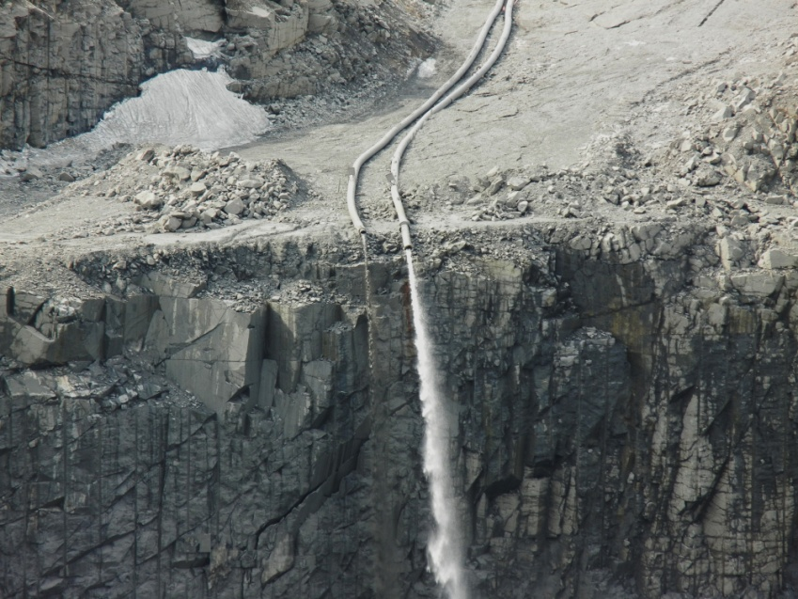
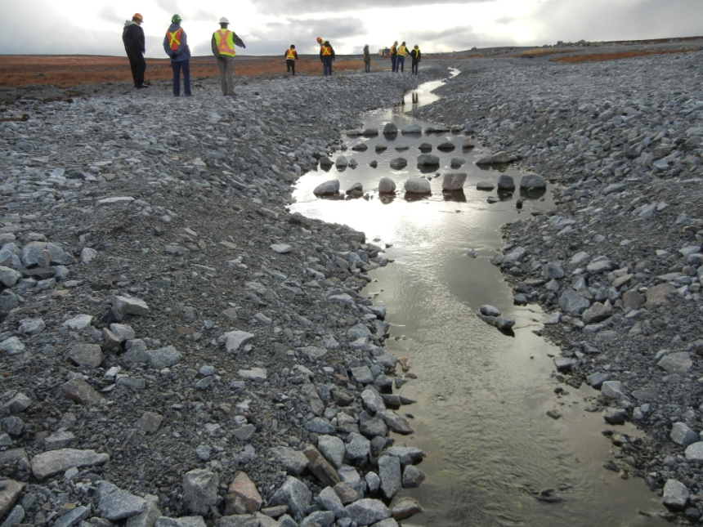
Water and Fish
Start of pumping of tailings into Beartooth pit
Pigeon Stream Diversion completed
Aquatic Effects Monitoring Program reviewed and further improvements made
  more detailed analysis of some contaminants
  new sampling sites in Lac de Gras
Nitrogen Response Plan submitted and revised to focus on prevention and reporting

Slide 8
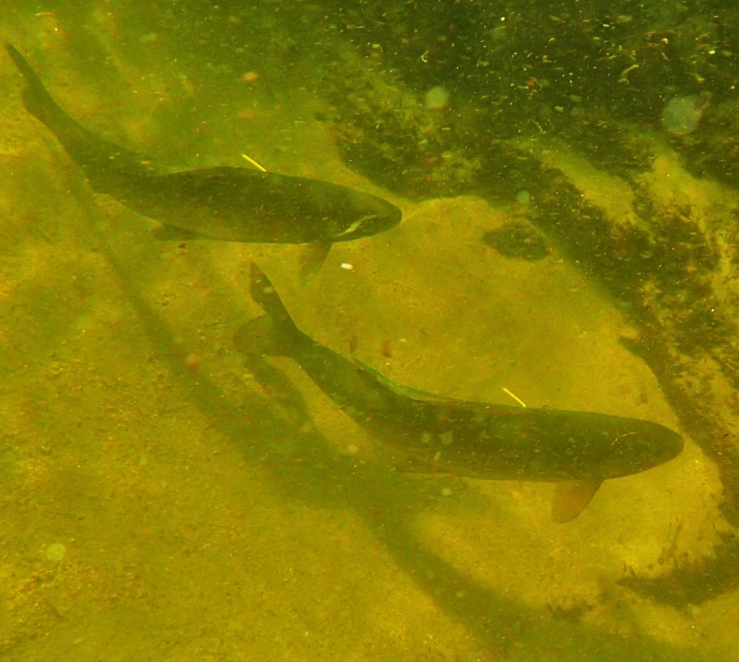
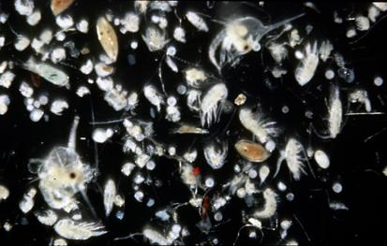
Water and Fish
Changing zooplankton communities have potential to affect fish health
Some issues with fish sampling cause uncertainty over dioxins and furans contamination
Evidence of possible hydrocarbon exposure in fish
Potassium: elevated in Leslie Lake above water quality objective

Slide 9
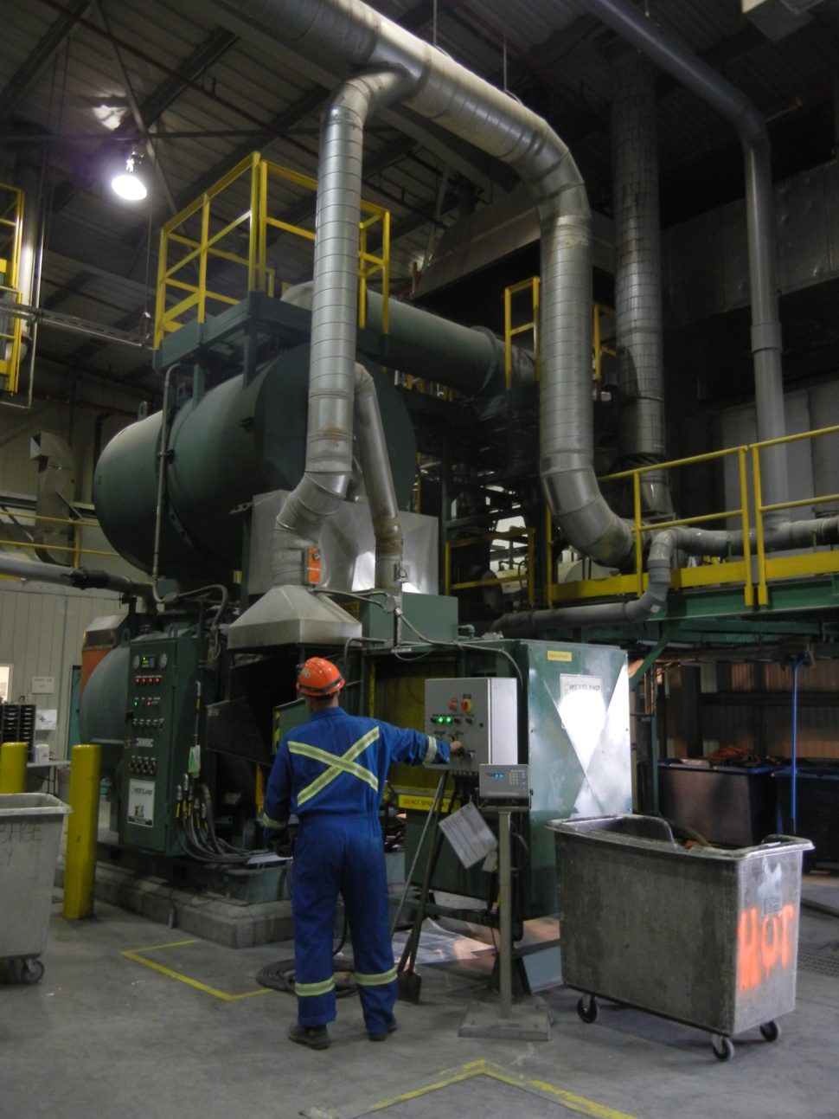
Air Quality
DDEC responded to SENES review of 2011 Air Quality Monitoring Program report in January 2014
DDEC making improvements to air quality monitoring
Incinerators tested in June 2013 with good results
Detailed operating procedures still needed for incinerators
Dust suppression should be reviewed

Slide 10
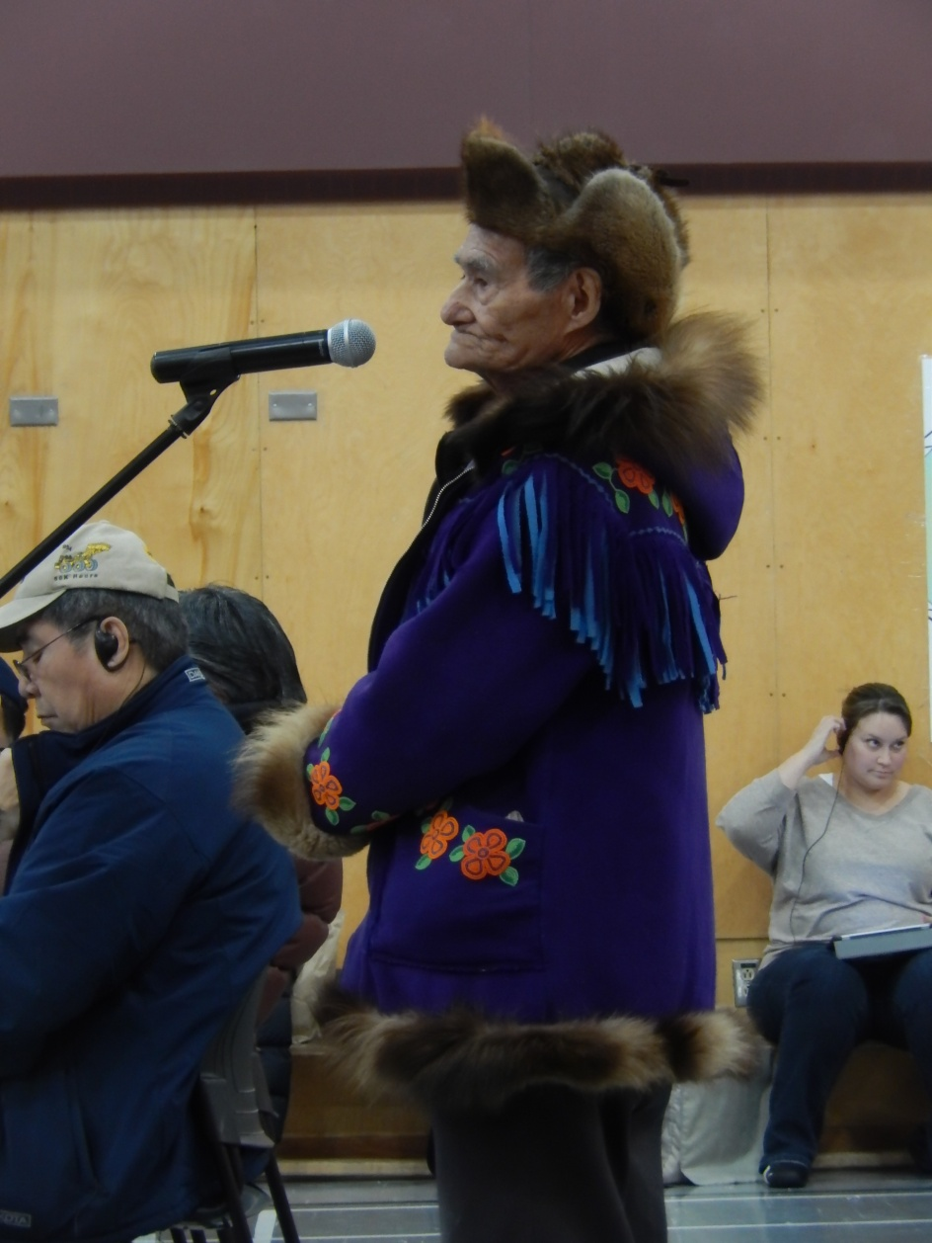
Traditional Knowledge
DDEC senior managers visiting communities
Community-based projects continue to be funded by company
DDEC conducted workshops on vegetation and reclamation
TK literature reviews prepared for company for reclamation planning
DDEC use of TK should be reported

Slide 11
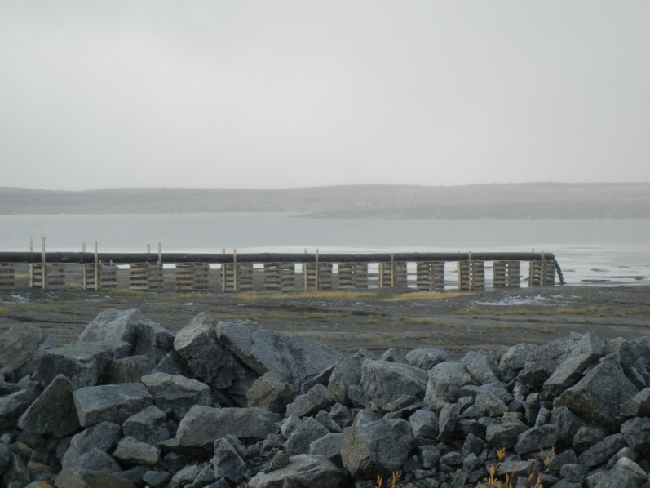
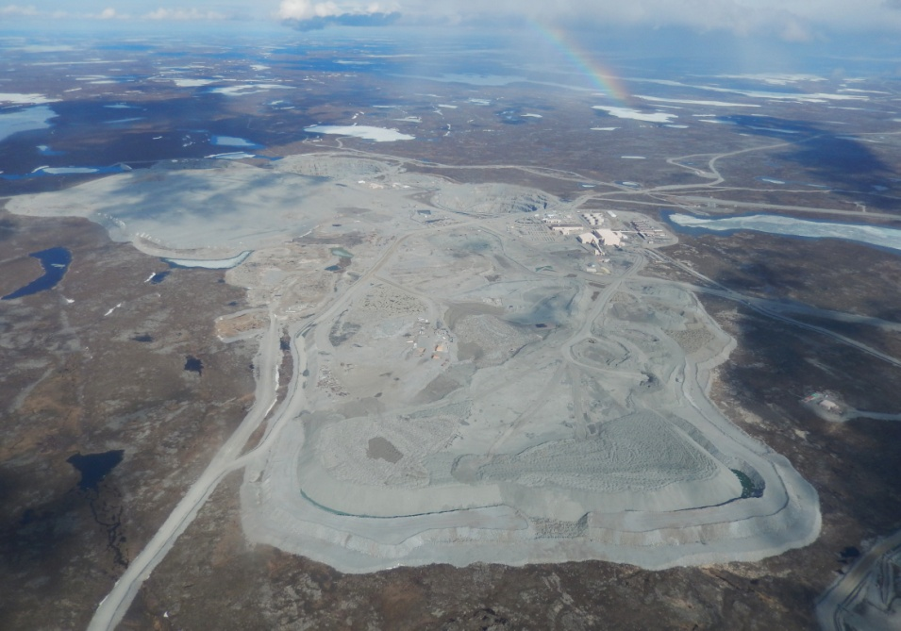
Processed Kimberlite and
Waste Rock Management
New design for Pigeon Waste Rock Pile approved
No major problems with seepage from waste rock piles
Some waste rock piles not freezing and company should prepare a plan to investigate and deal with this potential problem

Slide 12
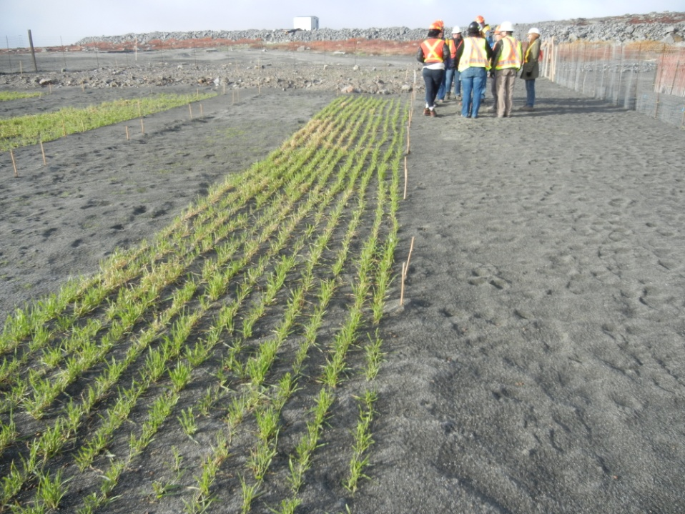
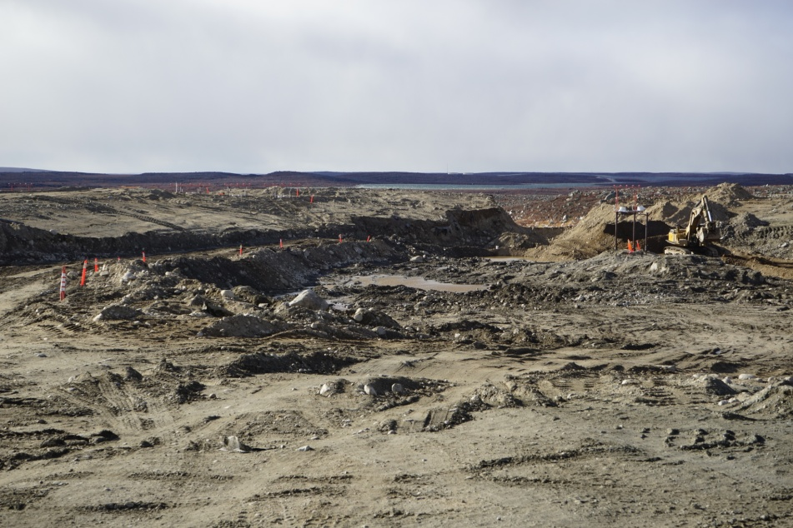
Closure and Reclamation
DDEC submits second Annual Progress Report on reclamation
  Major changes proposed to pit flooding and waste rock cover
  Further information requested and still under review
Old Camp Closure and Reclamation Plan submitted and approved (work to be done over 2-3 years)
Progressive reclamation; further delays in carrying out research
Very large gap in financial security not closed
Environmental Agreement security discussions recommence

Slide 13
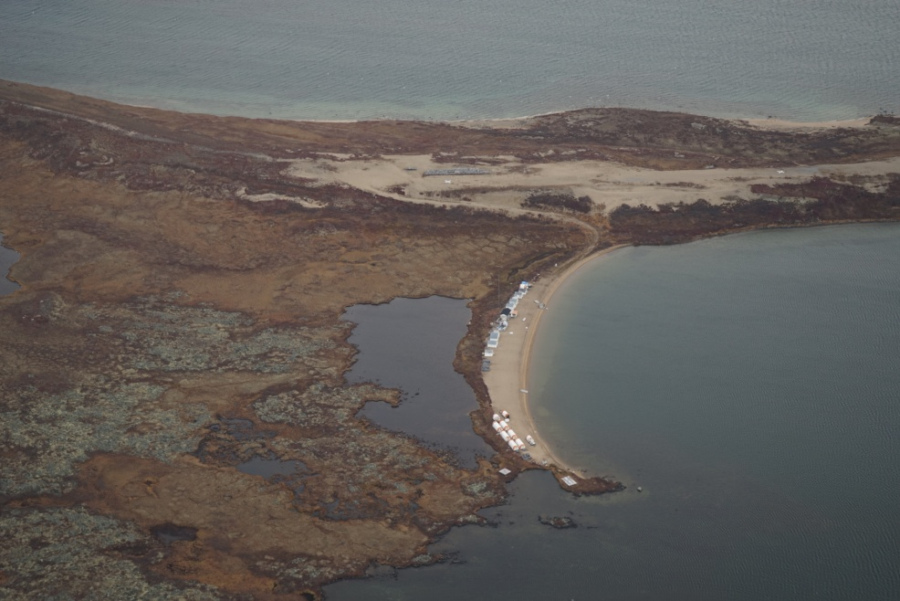
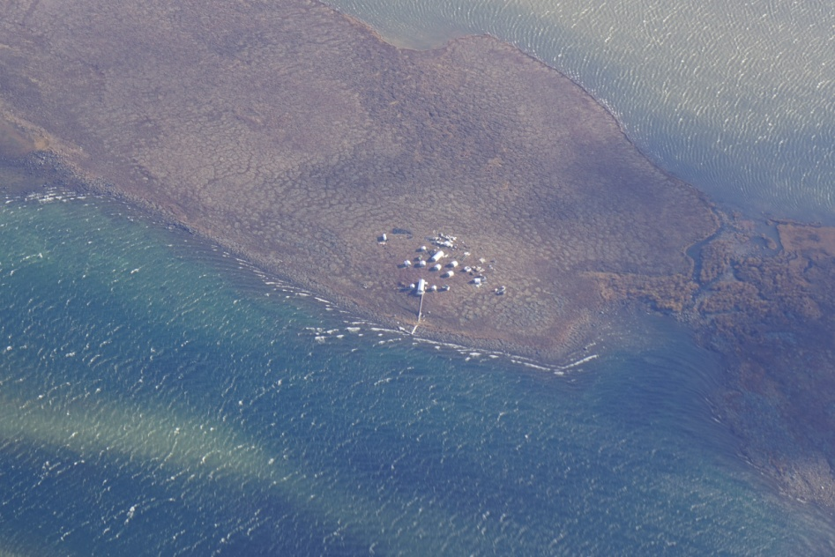
Regional Monitoring and Cumulative Effects
GNWT leading the Bathurst Caribou Range Plan, Agency participating and providing technical assistance
AANDC and GNWT have not developed best practices for mitigation of impacts on caribou
CIMP will focus on caribou, fish and water but relevance to Ekati not clear

Slide 14
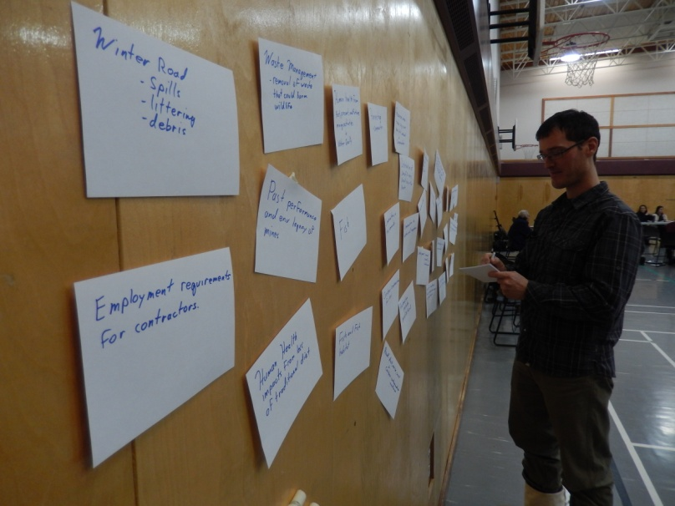
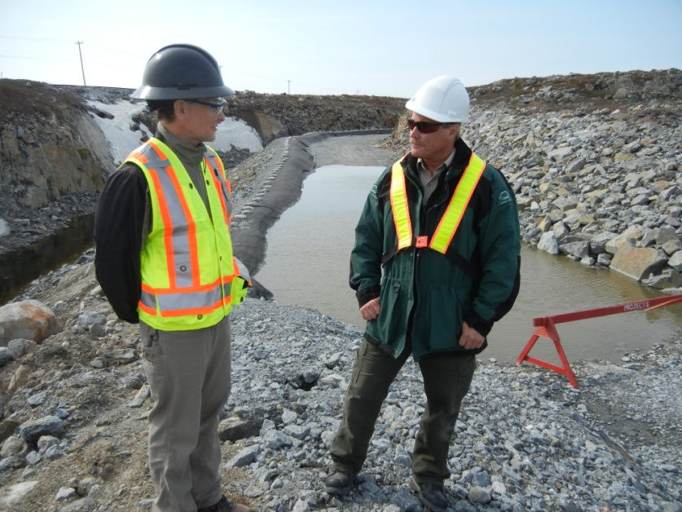
Assessment of the Regulators
Regulators effective and work together.
Major changes with Devolution effective April 1, 2014.
DFO complete turnover in staff, reduced mandate.
We look forward to stronger EC input.
AANDC new inspector continued high quality work, good participation in submission reviews. Financial security gap not closed, poor consultation on proposed changes to the Environmental Agreement

Slide 15
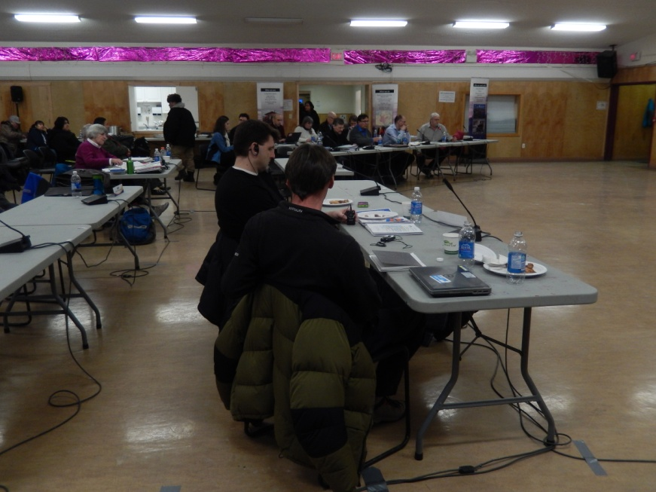
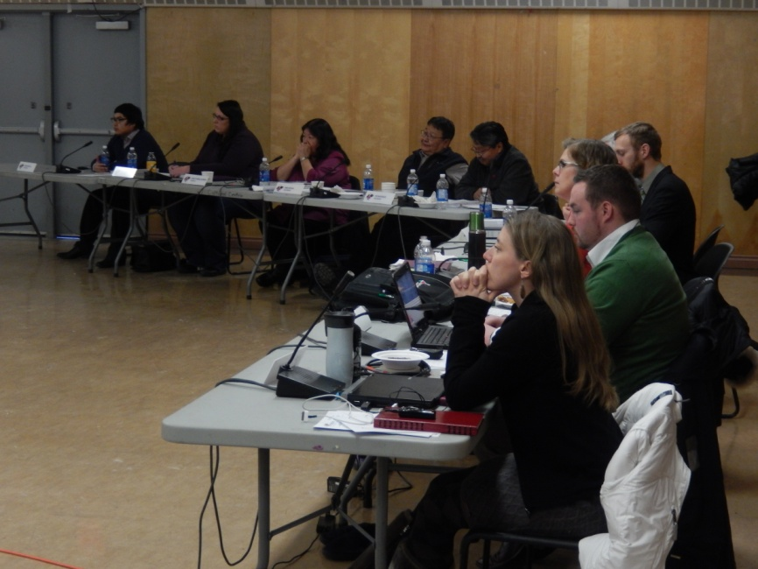
Assessment of the Regulators
GNWT-ENR good advice on air quality. Hosted wildlife monitoring workshop and Bathurst Caribou Range Plan workshops. Improved technical submissions on water licence related matters. New responsibilities came with devolution.
Agency pleased with WLWB process for Lynx water licence and land use permit. Agency disappointed with delays in financial security and moves to eliminate the WLWB.

Slide 16
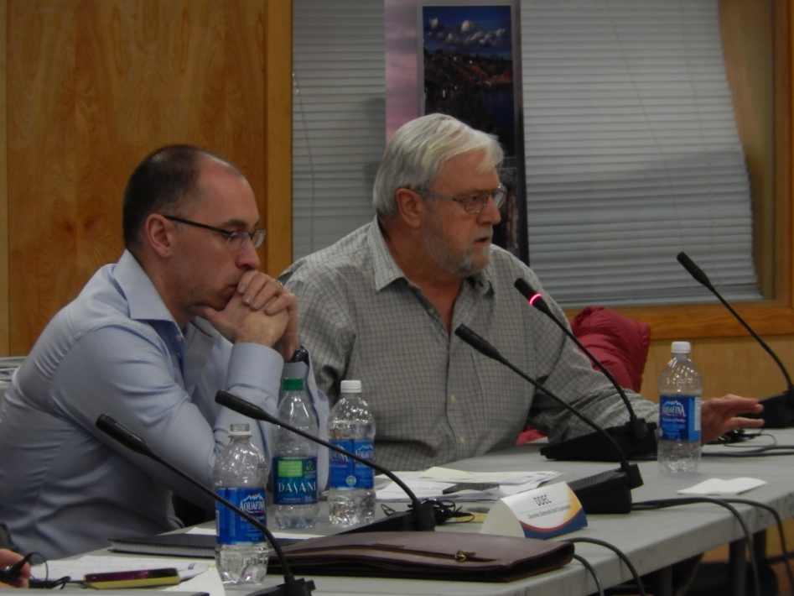
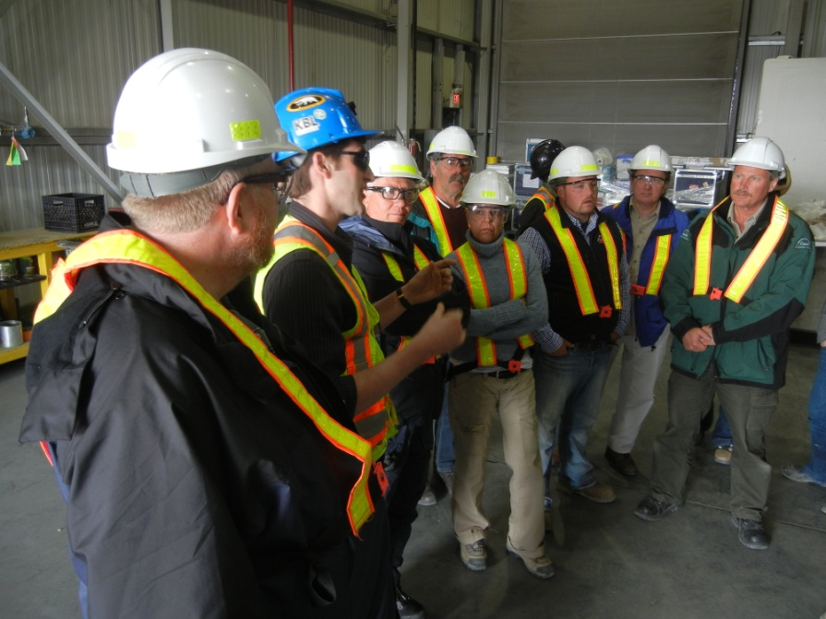
Assessment of Dominion Diamond
DDEC took over Ekati in April 2013. Most of the staff have stayed.
Agency had a good working relationship with DDEC.
Applications for Lynx and Jay-Cardinal Projects not up to previous standards.
Significant delays with reclamation planning and financial security.
Agency supported application for an award for company’s work on grizzly bear monitoring.
Incinerators working well and improved waste streaming at site.
DDEC senior managers going to the communities.

Slide 17
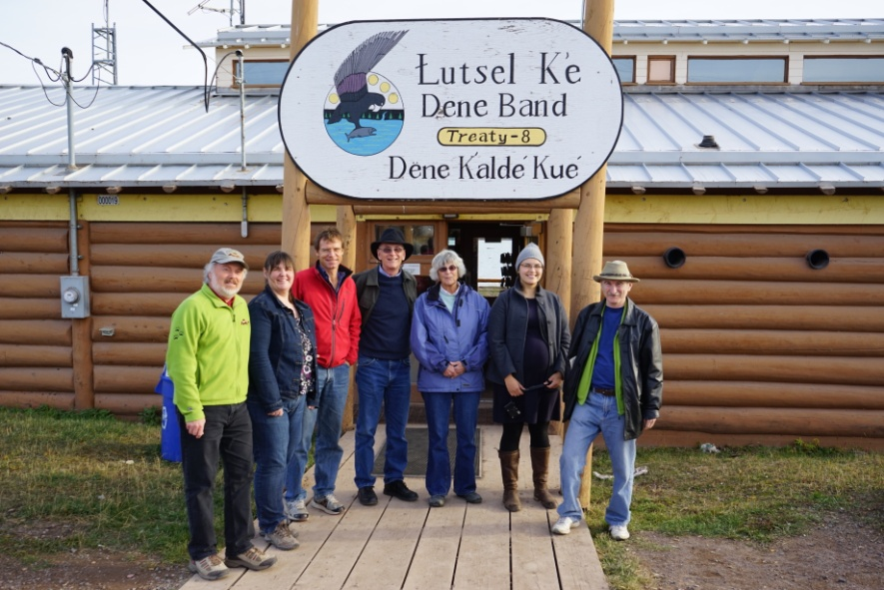
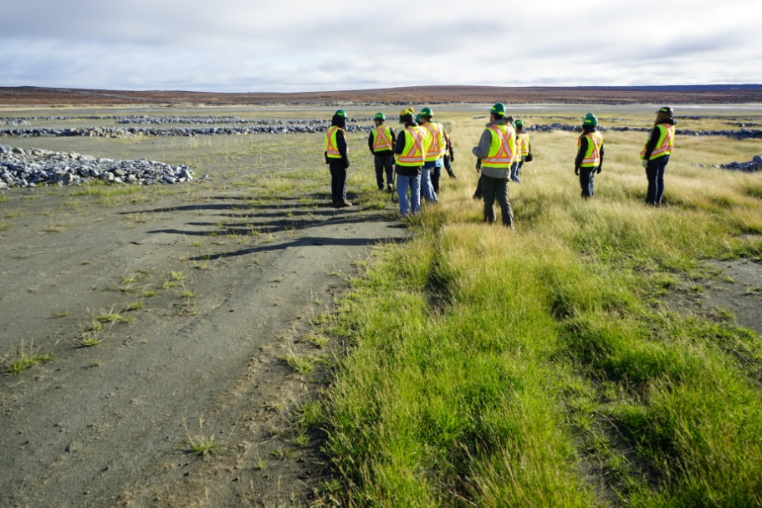
Recent Agency Activities
Agency is an active participant in the Jay Project environmental assessment
Agency actively involved in the review of the Misery power line
Agency visit to Lutsel K’e September 2014, staff site visit in June and September 2014
Participating in the review of financial security under the Environmental Agreement

Slide 18
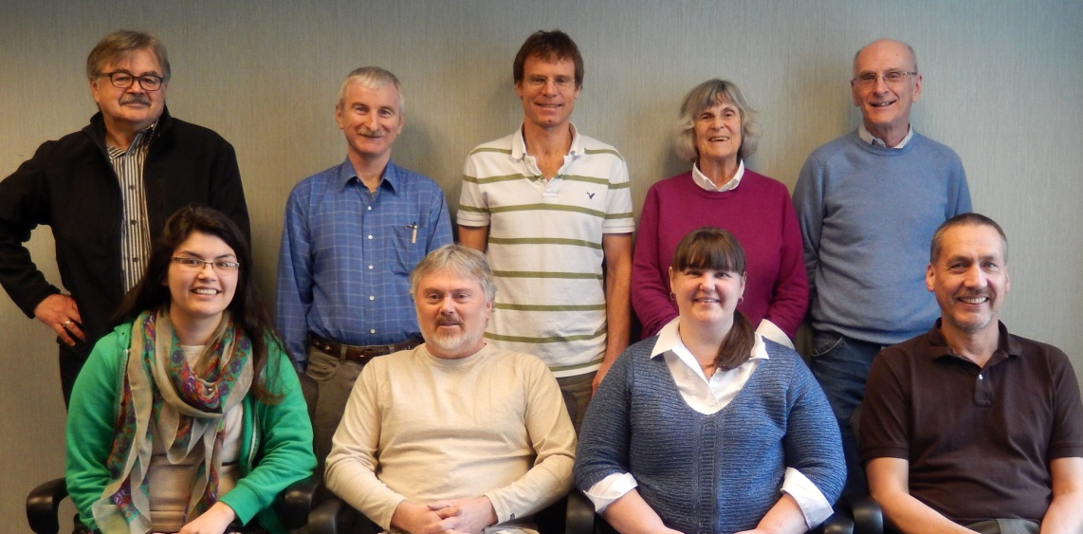
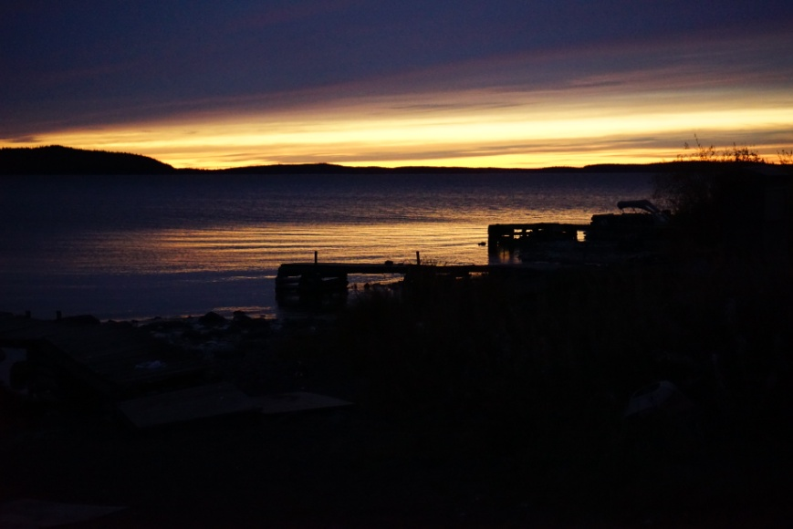

THANK YOU!
Independent Environmental Monitoring Agency
Telephone: (867) 669-9141 Fax: (867) 669-9145
Email: monitor1@yk.com Website: www.monitoringagency.net

